Slide 1

QUICKSORT ALGORITHM

Slide 2
Quick Sort
Quick sort is a highly efficient sorting algorithm and is based on partitioning of data into smaller arrays. A large array is partitioned into two array one of which holds values smaller than the specified value, say pivot, based on which the partition is made and another array holds values greater than the pivot value.

Slide 3
Quick Sort
Quicksort partition an array and then calls itself recursively twice to sort the two resulting subarrays.
This algorith is quite efficient for large-sized data sets as its average and worst-case complexity are O(nLogn) and O( n² ), respectively.

Slide 4
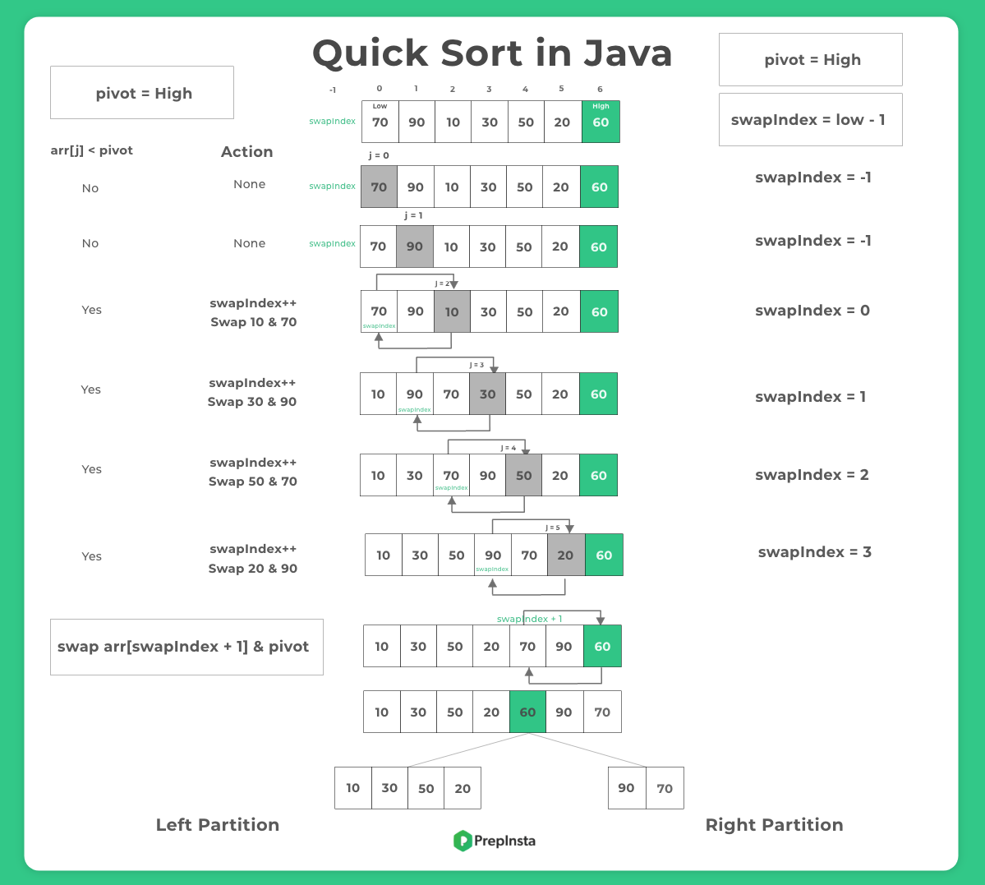

Slide 5
PROGRAM FOR QUICKSORT

Slide 6
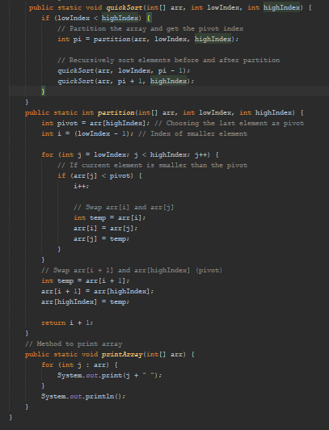
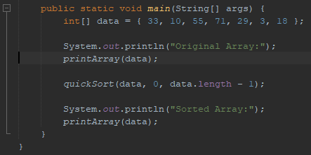
QUICKSORT();
ALGORITHM

Slide 7
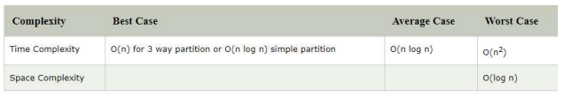
Time Complexity

